Slide 1
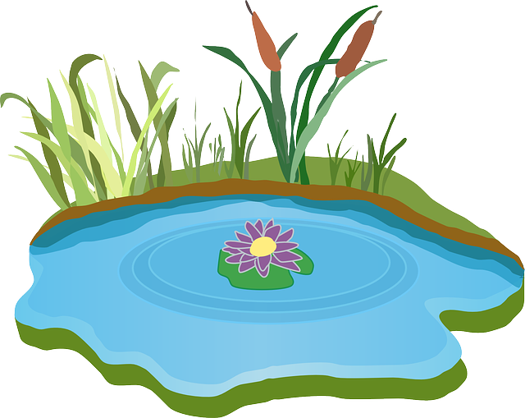
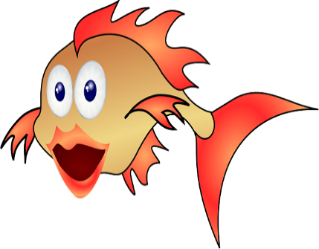
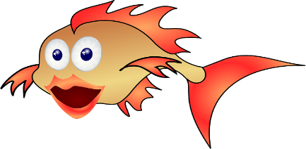
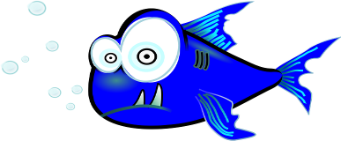
Characteristics of Living Things
What is Life?

Slide 2
What does it mean to be alive? What characteristics do living things have?

Slide 3
What is BIOLOGY?
Bio- means life
-ology means the study of
Biology is the study of life.

Slide 4
Why is it important to study Biology?
It can help us understand where humans came from
It can help us understand where humans are going
To understand our own bodies
To better understand the world we live in

Slide 5
What have we learned from studying Biology?
Learned how organisms get diseases and how to cure them
Learned why our bodies react certain ways to different situations and stimuli
Humans learned how every organism is important to the world we live in

Slide 6
When we say something this alive, what does it really mean?
Organism- a living thing
There are several characteristics of living things:
Living things are made up of 1 or more cells.
Cells- the smallest unit of life

Slide 7
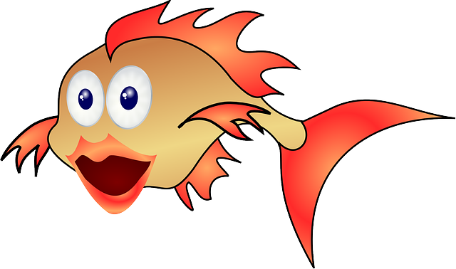
There are 7 easily observable characteristics that all living things do:
NUTRITION
MOVEMENT
EXCRETION
RESPIRE
REPRODUCTION
SENSE
GROW

Slide 8
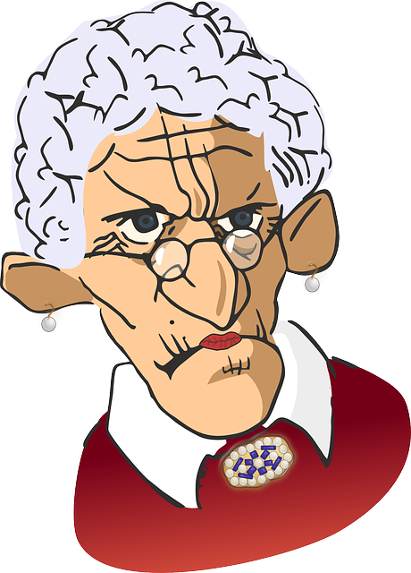
These 7 observable characteristics can be remembered using the mnemonic MRS GREN
M ovement
R espire
S ense
G rowth
R eproduction
E xcretion
N utrition
Hi, my name is MRS GREN

Slide 9
MOVEMENT: All living things move. They respond to their environment by moving. For example, a fish would move away from a predator if it swam close by.

Slide 10
OXYGEN
CARBON DIOXIDE
RESPIRE: All living things respire. That means that they get their energy by reacting oxygen with glucose to produce ENERGY (ATP). This process is called RESPIRATION.

Slide 11
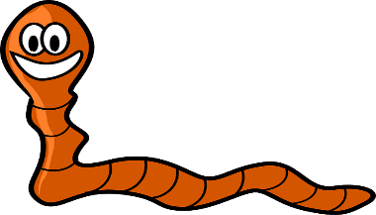
SENSE: All living things sense their surroundings. The fish for example, can sense what is around it. This is important so that it can find food and avoid predators which might be in its environment.

Slide 12
GROW: All living things grow, they usually start out smaller and then get bigger, and they develop throughout their life cycle. The fish for example grew from an egg and then will continue to grow until it reaches maturity.

Slide 13
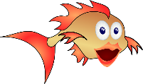
OFFSPRING
FERTILIZATION
REPRODUCE: All living things reproduce. They will produce offspring (children). The fish will lay eggs which can be fertilized by a male fish, this is known as sexual reproduction. These eggs will then turn into their offspring.

Slide 14
CARBON DIOXIDE
POOP
EXCRETE: All living things excrete: This means that they will get rid of waste materials. The fish for example eliminates carbon dioxide from its body and poops, both of which are waste products.
If living things did not get rid of waste products they would accumulate in the body and poison the organism.

Slide 15
Mmm.. That worm looks nutritious
NUTRITION: All living things need to get nutrients, living things do this in many different ways. The fish will get its nutrients from the food that it eats. It will then use these nutrients to support life processes

Slide 16
Determine if each of the following describes a living or nonliving thing:
Rust eating a hole in a metal bucket
An apple on a tree
Bacteria
Lightning
A dinosaur fossil
A wasp
A rock
Water
Fungus
Gases

Slide 17
Living vs. Non-Living
Living
Non-Living
An apple on a tree
Bacteria
A wasp
Fungus
Rust eating a metal bucket
Lightning
A dinosaur fossil
A rock
Water
Gases

Slide 18
Is it living or non-living?
There are things that we cannot classify as either fully living or non-living
A virus is a particle that must reproduce inside of a living cell.
Biotic- living
Abiotic- non-living

Slide 19
The 8 Life Processes:
Growth- organisms increase in size and develop.
Nutrition- eating food or water
Nutrients- the substances that an organism needs for energy, growth, repair, and maintenance.
Transport- movement of materials
Respiration- makes ENERGY (ATP)
Synthesis- to make complex substances

Slide 20
6. Excretion- the removal of wastes from the organism
7. Reproduction- process by which living things multiply.
8. Regulation- maintaining balance

Slide 21
Important Vocabulary
Metabolism- all the life processes
Homeostasis- to maintain a stable internal environment
If homeostasis is not maintained the organism will die.

